Slide 1



Predictive Maintenance using
Remaining Useful Life (RUL) Prediction
Capstone Project • Business-first, safety-aware ML for industrial equipment reliability
Group G7
Mehak Aggarwal • Avi Kishore Soni • Harshal Grover • Dewang Bakshy • Devesh • Gaurav Kumar
PGP in Data Science with Specialization in Gen AI
Prepared for faculty evaluation • Focus: uptime, cost reduction, and safety through actionable RUL insights

Slide 2



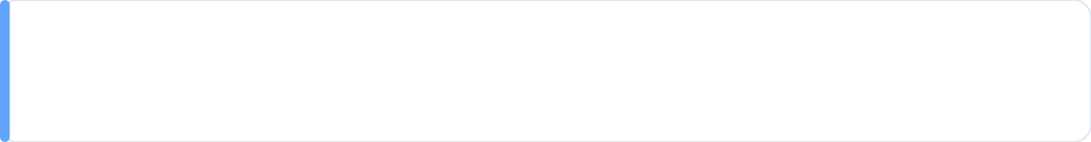



Problem Definition
Why predictive maintenance is a business-critical capability for modern industrial operations
Unplanned failures are expensive and disruptive
Unexpected breakdowns lead to production downtime, emergency repairs, safety risks, and missed delivery commitments.
Fixed-schedule preventive maintenance wastes resources
Replacing parts on a calendar basis often discards healthy components, increases labor cost, and adds unnecessary planned downtime.
Need: Predict Remaining Useful Life (RUL) to maintain at the right time
Estimate how many operational cycles a machine has left before failure, enabling just-in-time maintenance planning—neither too early nor too late.
Outcome: higher uptime • lower maintenance waste • improved safety
This project builds an ML-based RUL prediction system from multivariate sensor telemetry to support data-driven maintenance decisions.

Slide 3










Objective & Value Proposition
Turning sensor telemetry into actionable maintenance decisions (business-first capstone outcome)
Primary Objective
Value Delivered
Build a machine learning model to predict Remaining Useful Life (RUL) — a continuous estimate of how many operational cycles a machine has left before failure — using multivariate sensor telemetry.
Reduce unplanned downtime
Detect degradation early and avoid emergency stoppages.
Input signals (examples)
Plan just-in-time maintenance & inventory
Temperature • Vibration • Pressure • Current/Voltage • RPM • Load • Ambient conditions
Schedule work in planned windows; order parts only when needed.
Business question answered
Extend asset life & improve safety
“How long can we safely run this machine before maintenance becomes urgent?”
Avoid running equipment into catastrophic failure and reduce risk exposure.
Make predictions actionable with Risk Bands
Convert raw RUL into simple decisions for the shop floor: CRITICAL (act now) • HIGH (schedule next window) • MEDIUM (monitor) • SAFE (healthy)
Result: faster triage • fewer surprises • maintenance aligned to business priorities

Slide 4


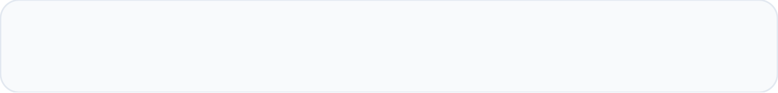



Dataset Overview
What we used, what we built, and what made this a real predictive maintenance problem
Data at a Glance
Key Data Challenges
120,000 records • 25 raw features • 35 engineered features
Noisy, non-linear sensor behavior
Machines degrade slowly, then drop sharply near failure (signal is not linear).
Raw inputs included
Missing values in key sensors
Machine settings + multivariate sensors:
E.g., coolant_flow gaps — typical in real telemetry pipelines.
Temperature • Vibration (RMS/Peak) • Pressure • Current/Voltage • RPM • Torque • Load • Humidity • Ambient temp • Shift / mode
Mixed operating regimes + leakage risk
Target
Different machine types/shifts create clusters; random time-series splits can leak “future” behavior into training.
Remaining Useful Life (RUL) — continuous prediction of cycles remaining before failure
Leakage-safe validation: machine-based train/test split
We split by machine_id (entire machines held out), so performance reflects how the model works on unseen assets in production.
Outcome: trustworthy generalization • avoids “memorizing” machines • aligns with real deployment

Slide 5




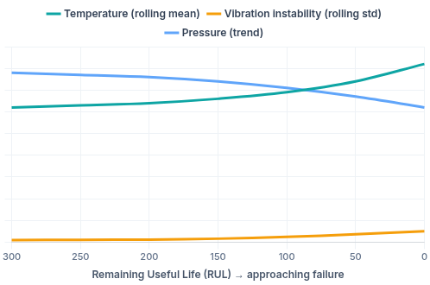
Key EDA Insights
What the data reveals about degradation patterns (signals that matter for business decisions)
Insights that shaped our approach
Degradation patterns (illustrative)
RUL distribution is left-skewed (capped at “healthy” max)
Most observations are in mid-life; failures appear as a sharp end-of-life region → focus accuracy near failure.
Temperatures rise as RUL approaches 0
Thermal stress is a strong late-stage signal and helps confirm imminent failure risk.
Vibration variance spikes near failure (“instability”)
Rolling standard deviation becomes highly predictive → instability is often the earliest reliable warning.
Pressure trends decline toward failure
Step-down behavior indicates pump/seal degradation patterns valuable for maintenance planning.
Anomaly flags correlate with lower average RUL
Anomaly = useful early-warning feature to prioritize inspection and reduce surprises.
The visual summarizes three common signals: temperature drift, vibration instability, and pressure decline as failure approaches.
Takeaway: degradation is non-linear; trend + instability features are more informative than raw sensor snapshots.
Note: chart is illustrative to communicate patterns observed during EDA (not exact raw values).

Slide 6


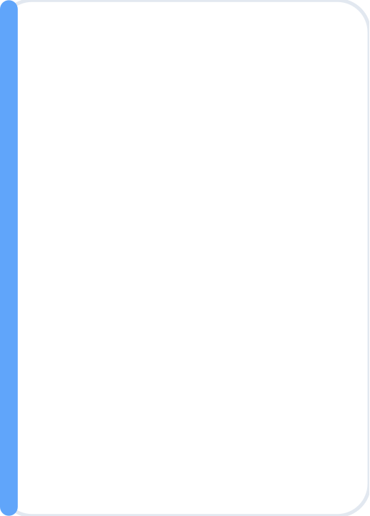














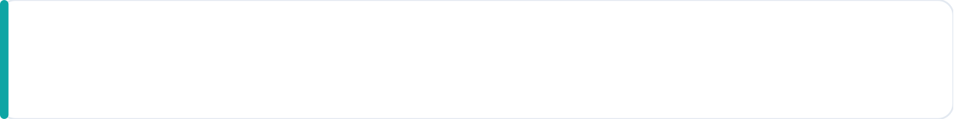

Solution Approach (High-Level)
A leakage-safe workflow that turns telemetry into actionable maintenance decisions
Step 1 — Split
Step 2 — Domain
Step 3 — Time
Step 4 — Model
Step 5 — Action
machine_id split
Stress features
Rolling & lag features
Ridge → RF → XGBoost
Safety layer + Risk bands
Prevents data leakage by ensuring test machines are truly unseen.
Thermal • Mechanical • Electrical • Environment • Age-normalized ratios.
Post-split 5-cycle rolling mean/std + lag-1 to capture trend + instability.
Progress from baseline to non-linear models; XGBoost selected for strongest generalization.
Clip predictions to 0–300 cycles; translate to CRITICAL / HIGH / MEDIUM / SAFE.
Outcome: realistic generalization
Outcome: wear & tear signals
Outcome: degradation “memory”
Outcome: operational decisions
Outcome: best fit to non-linearity
What makes this approach reliable for a real factory setting?
The workflow explicitly prevents leakage, learns degradation trends, and converts predictions into risk-based actions aligned to uptime and safety.
Business lens: prioritize catching imminent failures over “perfect” long-horizon estimates.
Note: Temporal features are engineered after the machine-based split to preserve causality and ensure evaluation matches deployment reality.

Slide 7


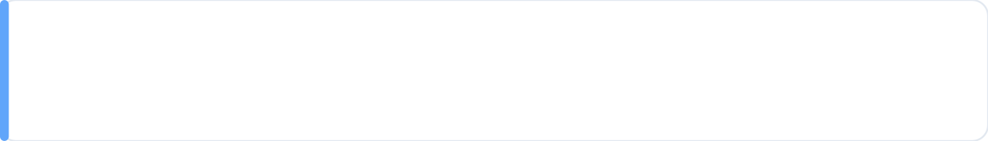



Feature Engineering Highlights
Translating raw telemetry into degradation signals (domain stress + temporal instability)
Thermal stress (overheating signal)
temp_delta_1 = temperature − ambient (corr −0.57) • temp_delta_2 = temperature_2 − ambient (corr −0.58)
Higher deltas → poorer heat dissipation → lower RUL
Mechanical strain + age-normalized stress (wear & efficiency)
torque_per_rpm (corr −0.59) and vibration_per_load capture overload / friction / abnormal vibration.
load_per_age (corr +0.40) • vibration_per_age (corr +0.39)
Normalizes behavior by usage/age → improves comparability across machines
Temporal stability (trend + instability signals)
Built 5-cycle rolling mean/std and lag-1 features per machine to capture gradual degradation + variance spikes.
Example: temperature_roll_mean (corr −0.24) indicates sustained heating before failure.
Outcome: smoother trends + early-warning instability → better RUL prediction
These engineered features convert noisy sensor readings into interpretable “stress” and “instability” signals that align with real machine degradation.

Slide 8


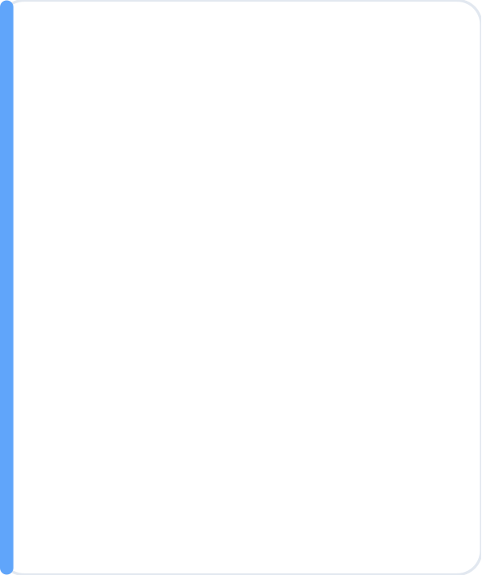






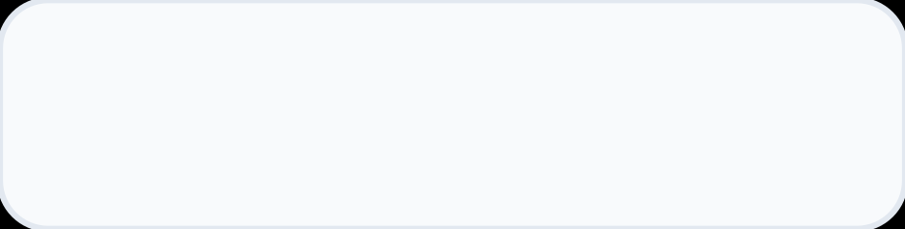


Model Comparison & Selection
We evaluated three models on unseen machines using RMSE (lower is better) and selected the most reliable option for operations.
Ridge Regression
Random Forest
SELECTED
XGBoost
Baseline (linear + stable)
Non-linear ensemble
Final model (selected)
RMSE (Train / Test)
RMSE (Train / Test)
RMSE (Train / Test)
19.03 / 18.91
18.17 / 18.93
17.88 / 19.10
Key takeaways
Key takeaways
Why it won
• Strong sanity baseline; stable under machine-based split
• Struggles with non-linear degradation (“cliff” near failure)
• Useful as a reference point for improvement
• Captures non-linear sensor interactions better than Ridge
• Generalizes well; limited smoothness for continuous RUL
• Solid but not the strongest for nuanced failure patterns
• Best at learning complex, non-linear degradation patterns
• Minimal overfitting (train RMSE close to test RMSE)
• Weighted focus on critical region to improve failure detection
Decision: XGBoost selected for best pattern learning + safe generalization on unseen machines
Next step: apply safety constraints and translate RUL into risk bands for operational action (CRITICAL/HIGH/MEDIUM/SAFE).

Slide 9







Final Results (Safety-Aware)
Performance summary on unseen machines with a business-first safety layer (clipping + conservative bias).
Test RMSE (after safety layer)
Overprediction rate
Generalization check
19.78
0.39
Consistent on
unseen machines
RMSE optimized for high-risk errors (large misses are penalized more).
Indicates a conservative tendency (safety-first).
Evaluation used a strict machine_id split so the model is tested on machines it never saw during training.
Interpretation: predictions stay within a practical error band for maintenance planning.
Business trade-off: accepts some false alarms to avoid “false safe” failures.
Why it matters: closer to real deployment conditions.
What this means for the business
The model is tuned to be risk-aware: it avoids dangerous “too-late” maintenance by leaning conservative, while keeping overall prediction error stable on new machines.
Next: translate RUL into Risk Bands to drive action (CRITICAL / HIGH / MEDIUM / SAFE).

Slide 10

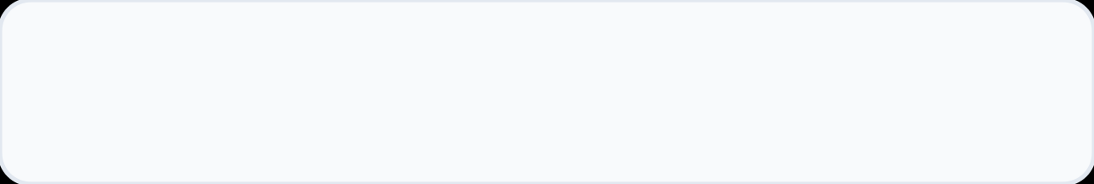


Business Impact & Risk Bands
Translating RUL predictions into simple, operational decisions for maintenance planning
Risk Bands (Action Layer)
Band Performance (Evidence)
We convert continuous RUL into four decision-ready bands to guide planning and prioritization.
OVERALL ACCURACY
0.83 (risk bands)
CRITICAL (≤ 85 cycles)
Immediate action — stop/repair before catastrophic failure.
HIGH (86–150 cycles)
CRITICAL recall: 0.71
Schedule in the next maintenance window; plan parts.
Catches most imminent failures (safety-first).
MEDIUM (151–280 cycles)
HIGH precision/recall: 0.75 / 0.69
Monitor closely; trend-based review.
Balanced identification of “needs attention soon”.
SAFE (> 280 cycles)
MEDIUM precision/recall: 0.85 / 0.96
Healthy — routine monitoring only.
Strong performance on normal operating conditions.
Business impact on the shop floor
Faster triage across machines • fewer surprise breakdowns • better parts planning • safer operations
Outcome: maintenance aligned to business priorities (urgent machines first, healthy machines left running)

Slide 11
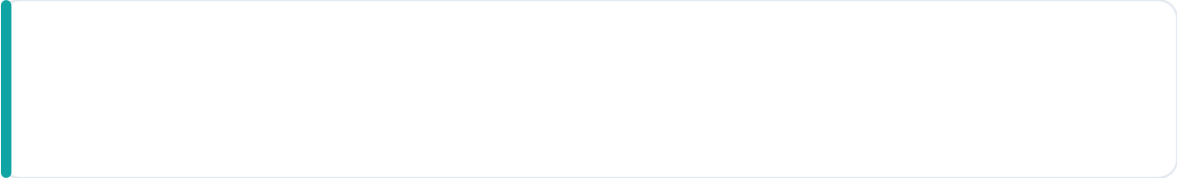

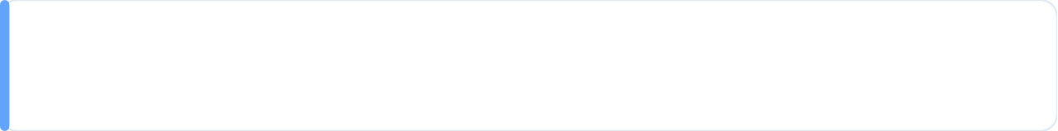



Production Readiness & Future Scope
How the solution can be operationalized today, plus key constraints and next enhancements
Readiness: practical steps to run on live factory data
Data contract & reliability
Consistent scoring
Monitoring
• Input schema validation
• Missing-value handling (robust imputation)
• Same feature logic for new data
• Stable outputs for unseen machines
• Track RMSE over time
• Recall for CRITICAL band
• Drift checks (sensor/operating changes)
Limitations (known trade-offs)
• Conservative bias: ~0.39 overprediction rate (safer alerts, more false positives)
• New machine classes: model needs retraining/transfer learning if equipment physics differ
Future scope (next upgrades)
• Explore LSTM / sequence models to learn temporal degradation without manual rolling features
• Deploy to edge / IoT gateways for low-latency, near real-time scoring on the factory floor
Operational goal: a reliable “maintenance decision layer” that prioritizes catching imminent failures while staying deployable in real conditions.

Slide 12



Thank You
Questions?
Group G7 — Predictive Maintenance (RUL)
Mehak Aggarwal • Avi Kishore Soni • Harshal Grover • Dewang Bakshy • Devesh • Gaurav Kumar
PGP in Data Science with Specialization in Gen AI
Capstone Presentation • Remaining Useful Life (RUL) Prediction

